Slide 1

Bootstrap Jumbotron
Ranken Technical College

Slide 2
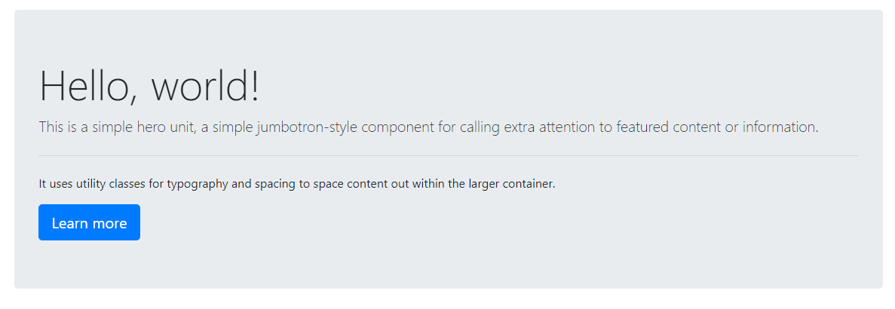
Jumbotron
A lightweight, flexible component to showcase key marketing messages on your site.
Sources
https://getbootstrap.com/docs/4.5/components/jumbotron/
https://www.abtasty.com/blog/above-the-fold/
https://www.optimizely.com/optimization-glossary/above-the-fold/

Slide 3
Above The Fold
Originated with newspapers.

Slide 4

A simple Jumbotron
<div class="jumbotron bg-dark text-white rounded-0">
<div class="container">
<h1 class="display-4">A Simple Jumbotron</h1>
<a class="btn btn-primary btn-lg" role="button" href="#">Learn more</a>
</div>
</div>

Slide 5
More Examples
https://getbootstrap.com/docs/4.5/components/jumbotron/

